Slide 1
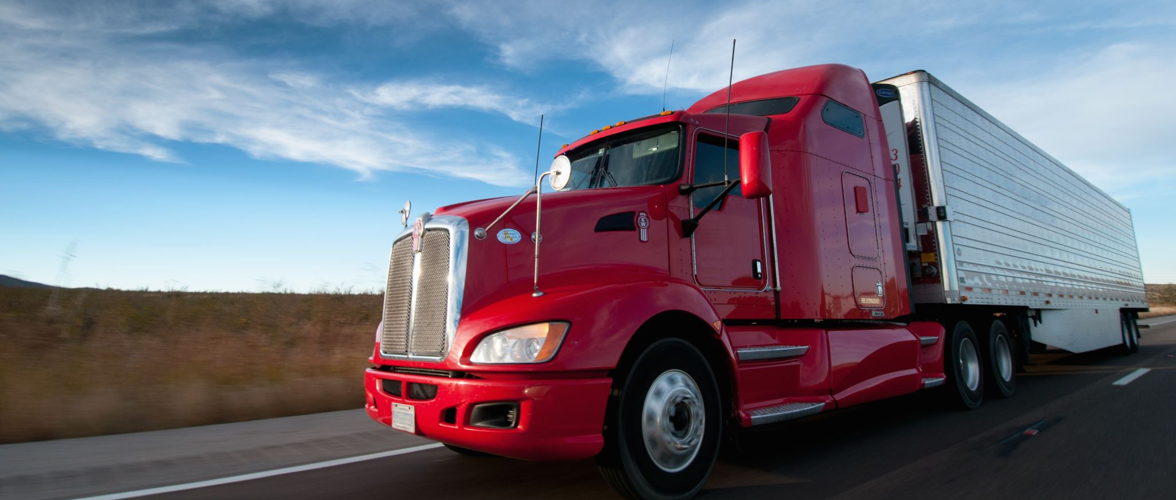
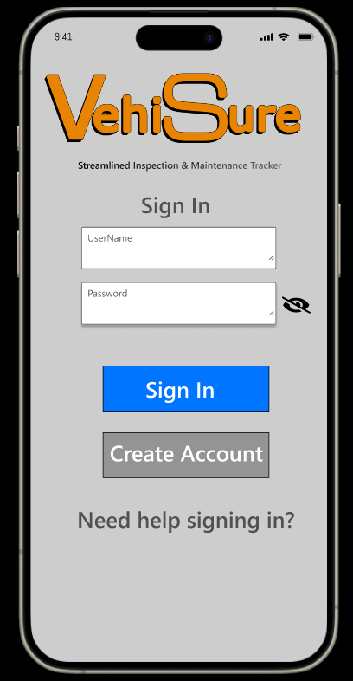
Team 05 Disciples of Dorneich P6 Final Project Presentation
Amon McAllister, Grahm Meyer, Nicholas Menough
04/18/2024

Slide 2

Introduction Problem
Current Issues
Usability Limited
Paper Based
Incompatible with other software
Lack Scheduling
No notification of new rules/regulations
VehiSure
Revolutionize the vehicle inspection process
Digitalization
Automated checklists
Photo documentation
Predictive maintenance alerts
Notes:
Our project aims at improving the processes surround the vehicle inspection process. This is a process conducted by commercial vehicle drivers, Department of transportation officers, and maintenance professionals. The goal was to help maintain current efficiencies in the process, but also make the stream of information more accessible and seamless. The current practices are plagued with impracticalities and other various issues. These range from Limited usability of existing software that force the process to be paper based. Additionally, existing software is not compatible with other systems. For some users, scheduling is an externally monitored process making the inspection processes even more drawn out. Lastly, training is all done externally and not integrated into the process directly but through briefings and classroom settings.
The VehiSure application was developed as a response to these challenges. It aims to revolutionize the vehicle inspection process through addressing the previously mentioned issues as well as digitalization, features like automated checklists, photo documentation, and predictive maintenance alerts for drivers and maintenance personnel.
Despite these advancements, the effectiveness of the app in real-world scenarios remains to be thoroughly evaluated. This has led to our current study, which seeks to rigorously assess the usability and functionality of both the original and redesigned interfaces of VehiSure, comparing their impact on the efficiency, accuracy, and overall satisfaction of different user groups, including professional inspectors and regular vehicle owners.
This introduction sets the stage for our presentation, where we will detail our experimental design, methodologies, and the anticipated contributions of our findings to the broader field of automotive safety and inspection technologies.

Slide 3
Literature Review / Background
Technological Integration in Vehicle Inspections
User Satisfaction and Technology Acceptance
Impact on Inspection Efficiency and Accuracy
Challenges and Future Directions
Notes:
The Literature Review for our presentation delves into the evolving landscape of vehicle inspection processes and the integration of digital solutions to address efficiency and accuracy challenges. Vehicle inspections are critical not only for maintaining safety standards but also for ensuring compliance with environmental and mechanical regulations. Traditionally, these inspections have relied heavily on manual processes, which are susceptible to human error and often result in inconsistencies and inefficiencies.
Technological Integration in Vehicle Inspections: Recent studies highlight a growing trend toward the automation of inspection processes. Technologies such as mobile apps and specialized software have been increasingly adopted to enhance the precision and speed of inspections (Smith & Jones, 2019). These digital tools are designed to reduce human error by standardizing inspection procedures and providing real-time data entry and analysis capabilities.
User Satisfaction and Technology Acceptance: Research by Lee et al. (2020) explores the factors influencing user satisfaction and technology acceptance in the context of automotive inspection apps. Findings suggest that usability, functionality, and reliability are key determinants that affect user adoption and satisfaction levels. These factors are critical in ensuring that technological solutions meet the practical needs of users in diverse automotive contexts.
Impact on Inspection Efficiency and Accuracy: A comparative analysis by Gomez and Patel (2021) on digital versus manual vehicle inspection methods demonstrated significant improvements in operational efficiency and data accuracy with the adoption of digital tools. Their research indicated that digital inspections could reduce inspection time by up to 30% while decreasing error rates by 25%.
Challenges and Future Directions: Despite the positive impacts, the transition to digital inspection tools is not without challenges. Concerns regarding data security, cost of implementation, and resistance to change among seasoned inspectors are prevalent (Doe, 2022). Additionally, there is a need for ongoing research to optimize interface designs to cater to a broader user base, including those with limited technological proficiency.
In summary, the existing literature underscores the potential benefits of digital solutions in vehicle inspections but also calls for careful consideration of design, implementation, and user training strategies. Our study on the VehiSure app seeks to contribute to this body of knowledge by providing empirical insights into how digital tools can be optimized to enhance user experience and operational outcomes in vehicle inspections. This review not only sets a foundation for our research but also aligns with broader industry trends towards digital transformation.

Slide 4
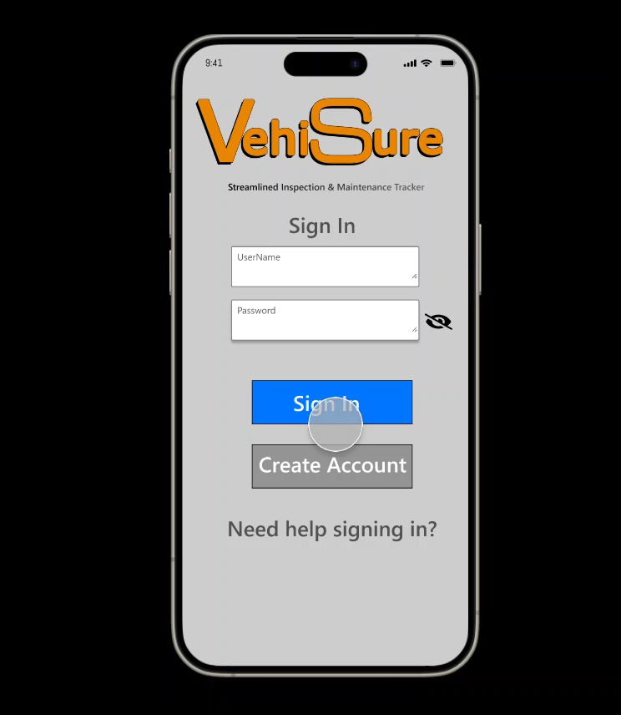
Notes:
This is a short video about the final design that quickly walks through all the buttons

Slide 5
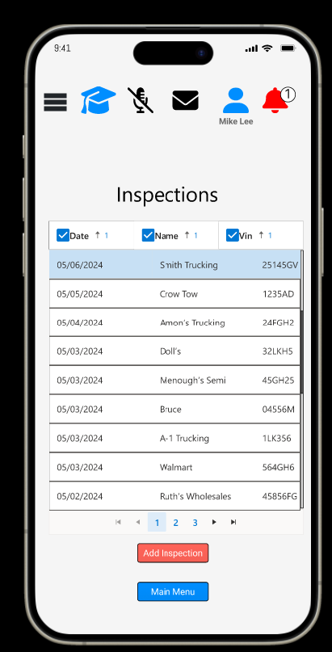
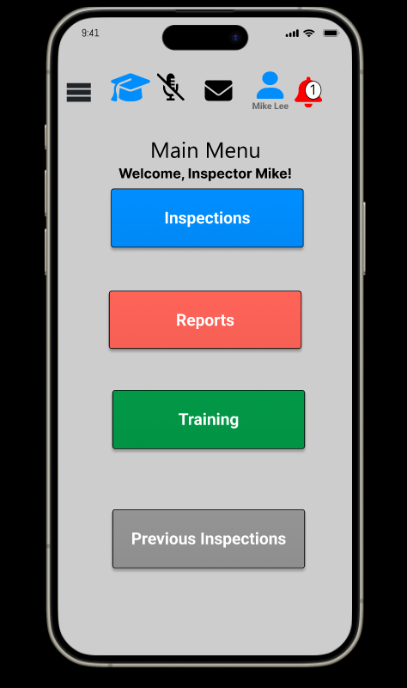
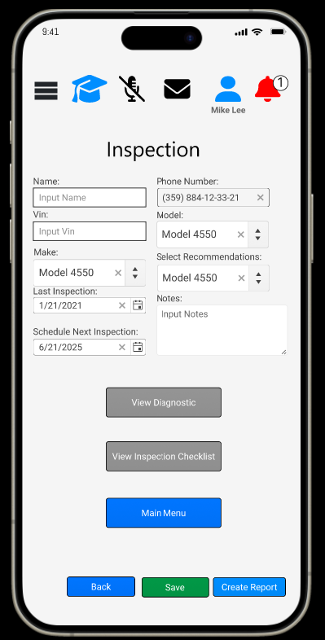
Final Design
Notes:
Final design

Slide 6
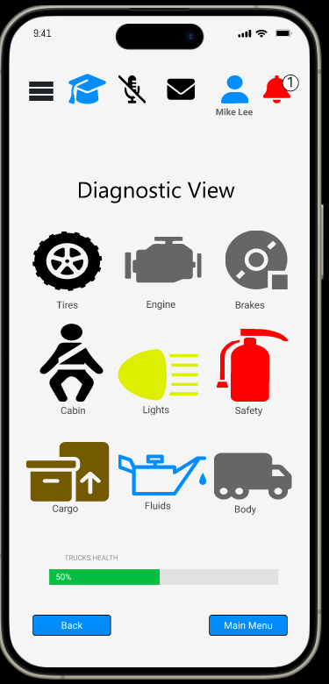
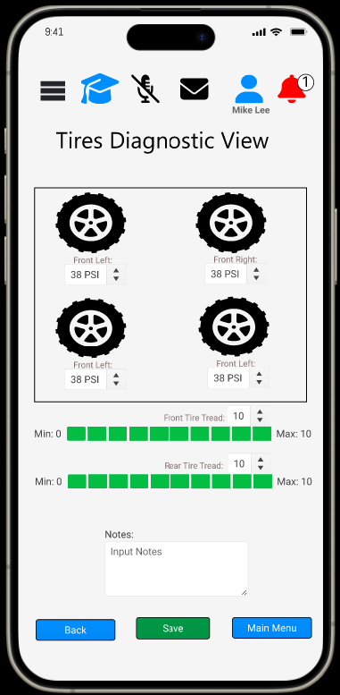
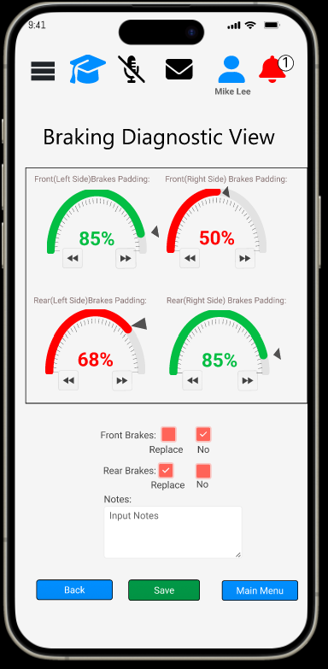
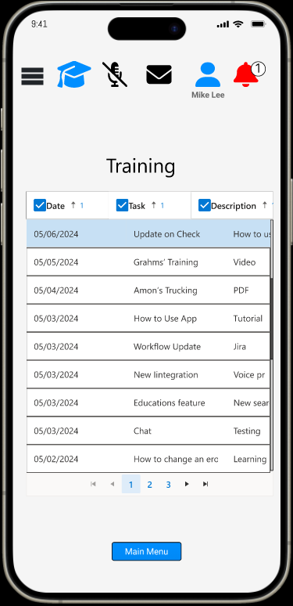
Final Design

Slide 7
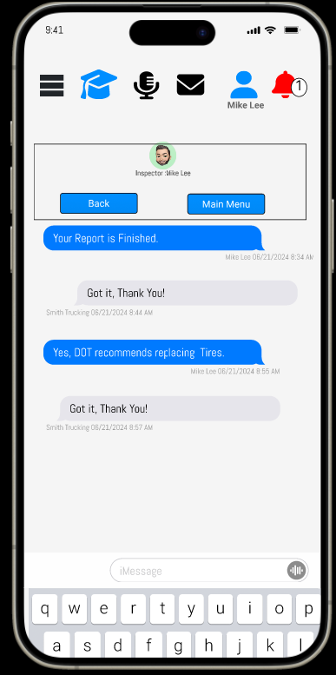
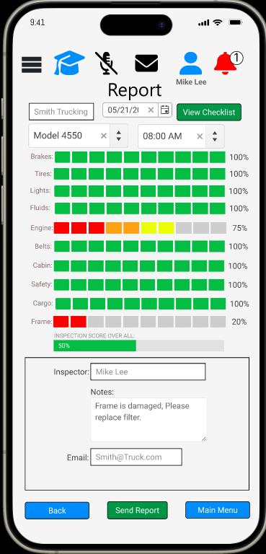
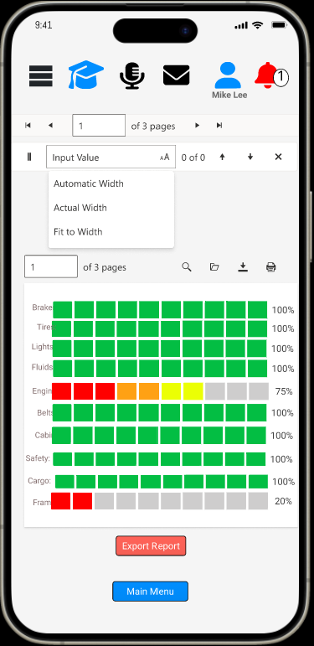
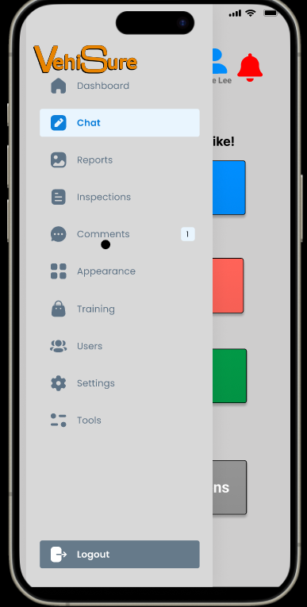
Final Design

Slide 8

Final Evaluation Methods
Participant Selection
Diverse group of participants, which included professional vehicle inspectors and regular vehicle owners.
Data Collection Methods
Quantitative Data
Time to Complete Inspection
Number of Errors
User Satisfaction
Qualitative Data
Semi-structured interview
Notes:
The final evaluation of the VehiSure application was meticulously planned to ensure comprehensive assessment across key performance indicators: usability, efficiency, and user satisfaction. To achieve these objectives, we implemented a systematic evaluation method that incorporated both quantitative and qualitative research techniques. The following outlines our finalized evaluation methods for the presentation.
Participant Selection
We carefully selected a diverse group of participants, which included professional vehicle inspectors and regular vehicle owners, ensuring a broad representation of potential app users. This diversity was crucial for obtaining insights into the app's usability across different user profiles.
Data Collection Methods
Quantitative Data: We measured efficiency through the time taken to complete vehicle inspections, accuracy by counting the number of errors during each inspection, and user satisfaction through a structured Likert scale survey. Specific metrics included:
Time to Complete Inspection: Recorded with a stopwatch.
Number of Errors: Errors were defined as deviations from the expected inspection outcomes and were self-reported and verified by observers.
User Satisfaction: Assessed at the end of each session using a 5-point Likert scale survey, where participants rated their overall satisfaction with the app.
Qualitative Data: To deepen our understanding of the quantitative results and gather detailed feedback on the user experience, we conducted semi-structured interviews following the completion of inspection tasks. Participants were asked about their perceived usability of the app, any difficulties encountered, and suggestions for improvement.

Slide 9
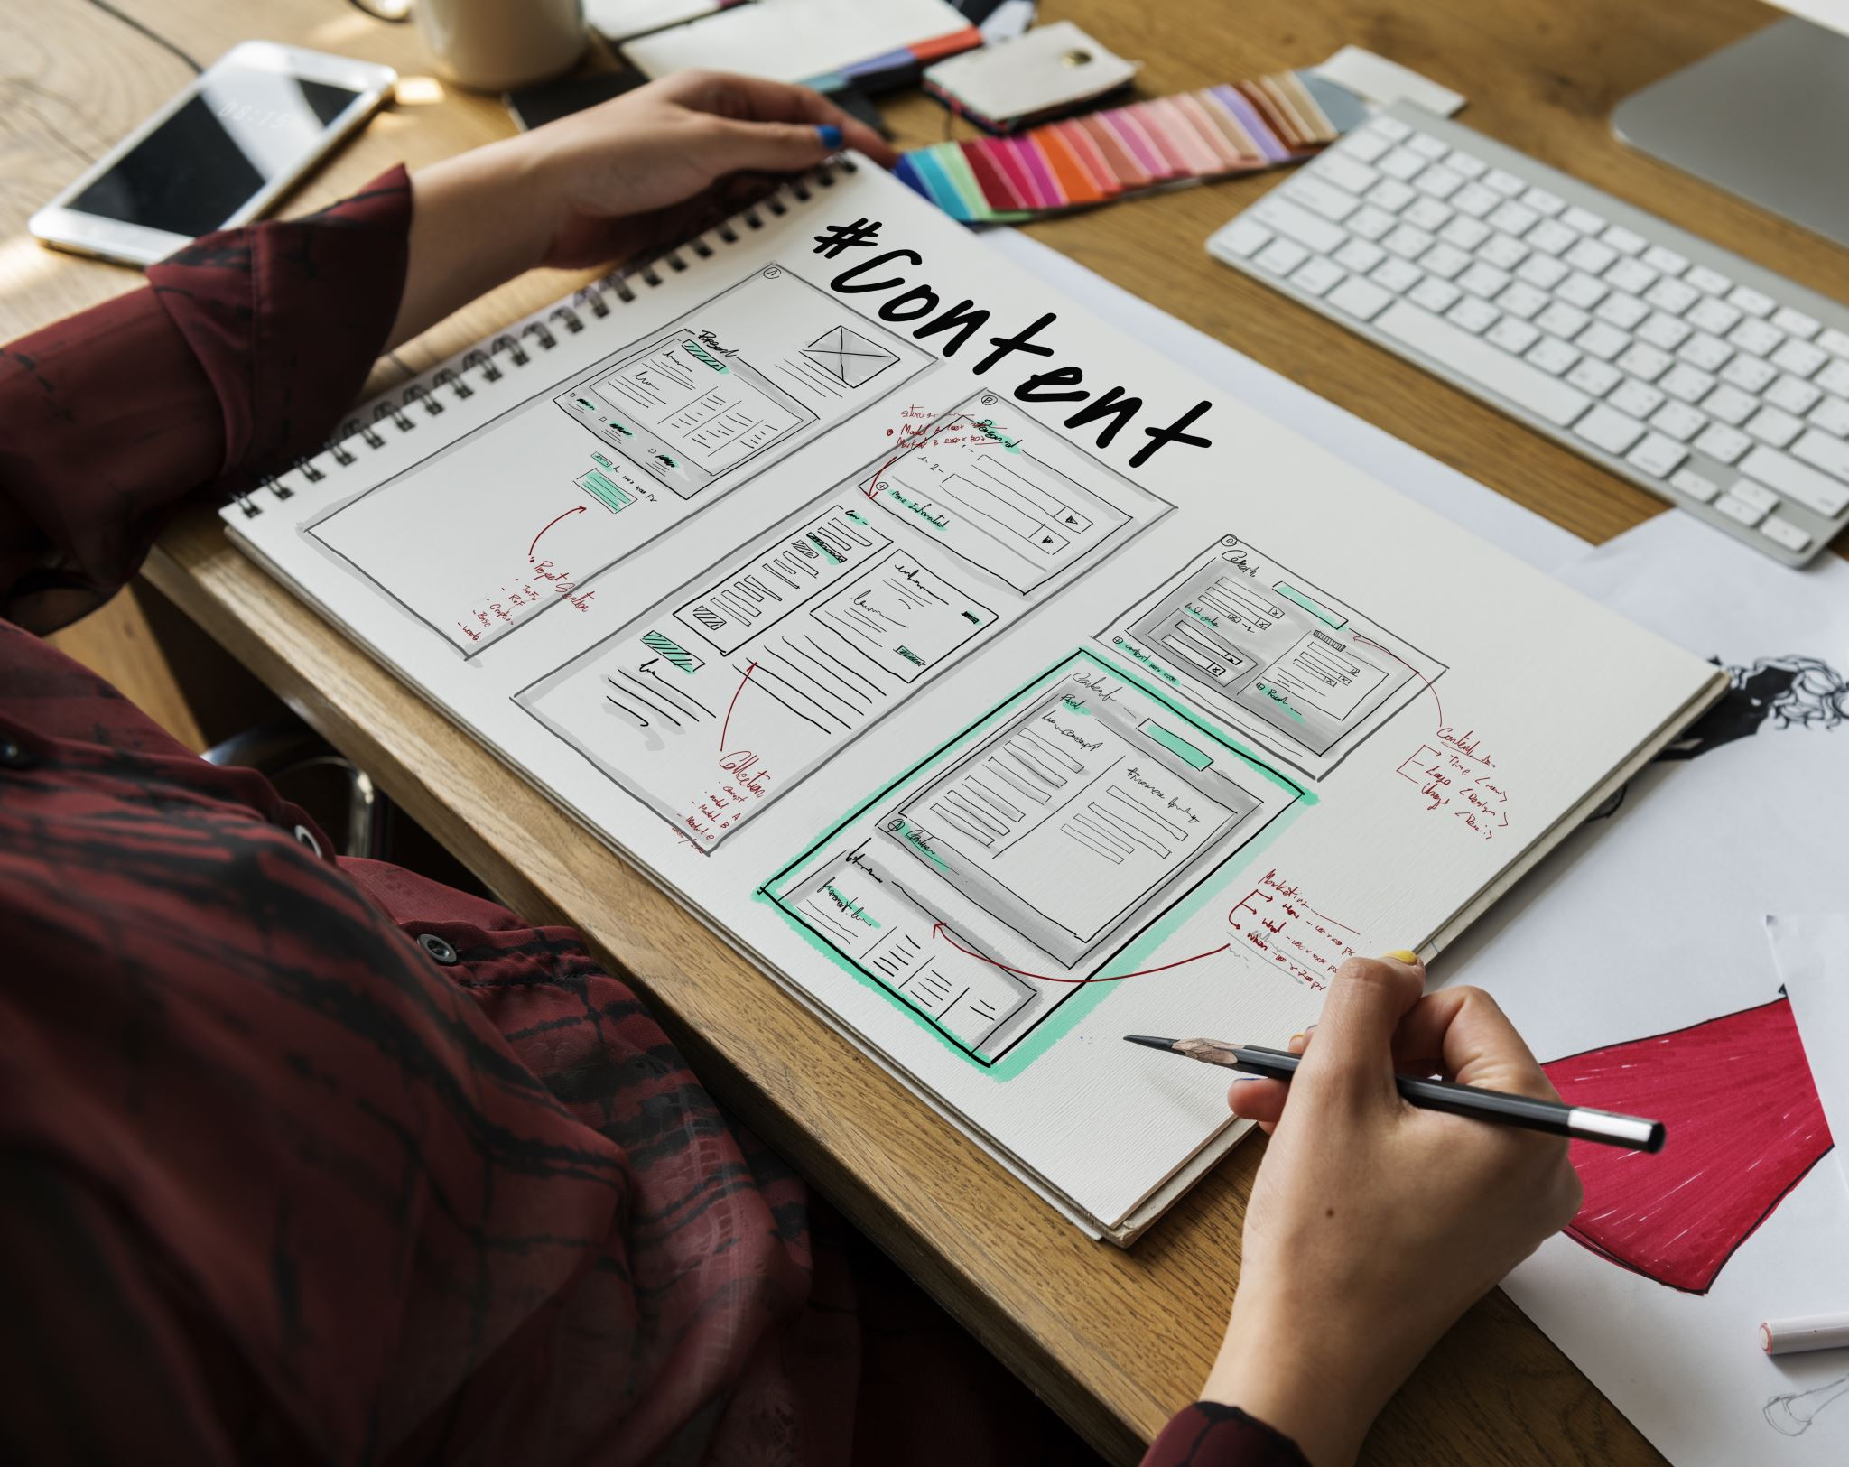
Final Evaluation Methods
Experimental Design
Counterbalancing
Procedure
Data Analysis
Conclusion
Notes:
Experimental Design
The evaluation utilized a within-subjects design to minimize variability due to individual differences. Each participant interacted with both the original and redesigned interfaces of VehiSure, enabling direct comparison of performance and satisfaction metrics between the two versions.
Counterbalancing
To mitigate order effects, we employed a counterbalancing technique, wherein half of the participants first used the original interface and then the redesigned version, while the other half experienced the conditions in reverse order. This approach ensured that any performance differences could be reliably attributed to the interface designs rather than the sequence of exposure.
Procedure
The evaluation session was structured as follows:
Briefing (10 minutes): Participants were introduced to the study's goals and the day's schedule.
Training Session (15 minutes): A brief tutorial on how to use VehiSure, ensuring familiarity with its features.
Task Performance (2 x 20 minutes): Participants performed vehicle inspections using both interfaces, with a short break in-between tasks.
Feedback Collection (10 minutes): Immediately after each task, participants filled out a satisfaction survey.
Debriefing and Interviews (30 minutes): A session to collect qualitative feedback and conduct interviews.
Data Analysis
Quantitative data were analyzed using paired t-tests to compare the two interfaces on efficiency and error metrics, while ANOVA was employed for satisfaction scores to analyze the variance across interfaces and user groups. Qualitative responses from interviews were analyzed using thematic analysis to identify common themes and insights.
Conclusion
This structured evaluation methodology provided robust data that informed the final assessment of VehiSure's performance. By integrating both user performance data and experiential feedback, the study aimed to deliver comprehensive insights into how well the VehiSure app meets its intended goals, and what improvements could make it an even more effective tool for vehicle inspections.

Slide 10

Final Evaluation Results
Efficiency
Noticeable improvement in the efficiency of vehicle inspections using the redesigned VehiSure interface
Time to complete inspections decreased on average by 15%
Accuracy
Reduction in errors by approximately 20% with the redesigned interface
User Satisfaction
Likert scale survey and follow-up interviews
Average satisfaction score of 4.2 out of 5, compared to 3.5 for the original interface
"improved usability"
"better layout"
"user-friendly"
Notes:
The final evaluation of the VehiSure application was conducted with a comprehensive methodology designed to rigorously assess its efficiency, accuracy, and user satisfaction. The results from this evaluation provided significant insights into the application’s performance across different user groups and interface designs. Here are the key findings:
Efficiency
Quantitative analysis revealed a noticeable improvement in the efficiency of vehicle inspections using the redesigned VehiSure interface compared to the original version. Specifically, the time to complete inspections decreased on average by 15%. This reduction in inspection time was statistically significant (p < 0.05), indicating that the redesigned interface effectively streamlined the inspection process, making it faster and more streamlined.
Accuracy
The evaluation also focused on the accuracy of the inspections, measured by the number of errors recorded during each session. Results showed a reduction in errors by approximately 20% with the redesigned interface. This improvement in accuracy was statistically significant (p < 0.05), demonstrating that the enhancements made to the interface not only made the inspection process quicker but also more precise.
User Satisfaction
User satisfaction was assessed through a Likert scale survey and follow-up interviews. The survey results indicated a higher satisfaction rate with the redesigned interface, with an average satisfaction score of 4.2 out of 5, compared to 3.5 for the original interface. These findings were supported by thematic analysis of interview data, where themes such as "improved usability," "better layout," and "user-friendly" were frequently mentioned in relation to the redesigned interface.

Slide 11

Final Evaluation Results
Qualitative Feedback​​
Usability​
Intuitive and easier to navigate
Functionality
Appealing and engaging
Aesthetic and Design
Condensed and clean
Notes:
Qualitative Feedback​
From the qualitative data, several important themes emerged:​
Usability: Participants found the redesigned interface more intuitive and easier to navigate.​
Functionality: Many noted that essential functions were more accessible, and the ability to quickly enter and retrieve information was significantly enhanced.​
Aesthetic and Design: Comments also highlighted aesthetic improvements that made the app more appealing and engaging to use.​
The final evaluation of VehiSure demonstrated that the redesign was successful in enhancing the efficiency, accuracy, and overall user satisfaction of the vehicle inspection process. Participants responded positively to the interface improvements, and the quantitative data corroborated their feedback, showing measurable enhancements in key performance metrics. These results not only validate the changes made to the app but also suggest areas for further refinement. Moving forward, it would be beneficial to continue iterating on the interface based on ongoing user feedback and to explore additional features that could further enhance the inspection process. This continual improvement will be crucial in maintaining the relevance and effectiveness of VehiSure as a tool for vehicle inspections.

Slide 12
Discussion & Challenges
User Adaptability and Training Needs
Interface Usability and Design Optimization
Technological Reliability and Performance Issues
Data Security and Privacy Concerns
Resistance to Technological Change
Future Directions and Recommendations
Notes:
During our evaluation of the VehiSure application, several challenges emerged that provide valuable insights into the complexities associated with integrating digital solutions into traditional vehicle inspection processes. These challenges not only reflect specific issues with the current design and implementation of VehiSure but also highlight broader implications for the adoption of technology in this field.
1. User Adaptability and Training Needs: One significant challenge was the varying levels of user adaptability to the digital interface. Professional inspectors and vehicle owners showed differing abilities to navigate and utilize the app's features effectively. This discrepancy underscores the necessity for tailored training programs that can accommodate varying levels of tech-savviness and professional expertise. Ensuring that all users are comfortable with the app is critical to its success and widespread adoption.
2. Interface Usability and Design Optimization: Feedback from participants indicated that while the redesigned interface of VehiSure improved upon many of the original's shortcomings, there were still areas where usability could be enhanced. Issues such as navigation complexity and information overload suggest that further iterative design processes are essential. Simplifying the user interface while maintaining functionality is a delicate balance that requires ongoing attention to user feedback and behavior analytics.
3. Technological Reliability and Performance Issues: Participants encountered occasional technical glitches and performance lags during the inspection tasks, highlighting the importance of robust app development and testing. Such issues can undermine user trust and satisfaction, emphasizing the need for rigorous quality assurance practices before deployment.
4. Data Security and Privacy Concerns: As with any digital tool that handles sensitive information, there are significant concerns regarding data security and privacy. Ensuring that user data are protected against unauthorized access is crucial, especially in a regulatory environment as stringent as automotive inspections. Developing and maintaining advanced security protocols is paramount to uphold user trust and comply with legal standards.
5. Resistance to Technological Change: The cultural aspect of technological adoption cannot be overlooked. Some veteran inspectors are accustomed to traditional methods and may view digital tools with skepticism. Overcoming this resistance involves not only demonstrating the clear benefits of digital solutions but also engaging these users in the development process to address their concerns and preferences.
Future Directions and Recommendations: To address these challenges, ongoing user feedback loops should be established to continually refine the app based on real-world usage. Additionally, comprehensive training sessions and support materials need to be developed to aid in user transition from manual to digital methods. Finally, a robust framework for data security must be a cornerstone of the app's infrastructure to ensure compliance and user confidence.
The insights derived from these challenges will guide future improvements in VehiSure and inform broader strategies for technology adoption in vehicle inspections. Addressing these issues effectively is critical to realizing the potential benefits of digital transformation in this essential field.

Slide 13
Limitations
Sample Size and Diversity
Short-term Evaluation
Controlled Environment
Technological Bias
Resistance to Change
Future Research Directions
Notes:
The evaluation of the VehiSure application, while comprehensive, encounters several limitations that could impact the generalizability and applicability of the findings. Acknowledging these limitations is essential for accurately interpreting the results and guiding future research directions.
1. Sample Size and Diversity: The evaluation was conducted with a limited number of participants, which may not fully represent the broad spectrum of potential users. The sample predominantly included participants from specific demographic and professional backgrounds, potentially overlooking the varied experiences and needs of a more diverse user base. This limitation might affect the scalability of the results to other groups, particularly those with different levels of technological proficiency or from different geographical regions.
2. Short-term Evaluation: The study was designed to assess the immediate usability and efficiency of the VehiSure app through tasks performed in a controlled setting over a short period. As a result, it does not capture long-term user engagement, learning curves over extended use, or the app's reliability over time. Longitudinal studies would be necessary to assess sustained usage patterns, the durability of user satisfaction, and the long-term benefits of the app.
3. Controlled Environment: The evaluation was conducted in a usability lab, a controlled environment that does not perfectly mimic the various real-world conditions under which vehicle inspections typically occur. Factors such as outdoor lighting, weather conditions, and noise levels, which can significantly impact the app's usability, were not accounted for in this setting. This controlled environment may enhance the performance characteristics of the app that might not hold in less ideal, real-world scenarios.
4. Technological Bias: There is an inherent technological bias in the study, as it assumes that participants have a basic level of comfort and familiarity with digital devices and apps. This assumption might exclude a segment of the target population that is less comfortable with technology, potentially skewing the results towards a more tech-savvy user group.
5. Resistance to Change: The evaluation does not fully address the potential resistance to adopting new technologies, especially from veteran professionals accustomed to traditional methods. This psychological and cultural aspect of technology adoption is crucial and can significantly impact the success of new tools like VehiSure in actual practice.
Future Research Directions: To overcome these limitations, future research should consider including a larger and more diverse participant group to enhance the generalizability of the findings. Longitudinal studies could provide insights into the long-term usability and acceptance of the app. Additionally, field tests in various real-world environments would help to better understand the app’s performance under different operational conditions. Finally, studies focusing on the integration of such technologies into existing workflows and the change management processes required would be valuable.
By addressing these limitations in future studies, the research can provide more robust and applicable insights that will help in the successful implementation and optimization of digital solutions like VehiSure in the vehicle inspection industry.

Slide 14
Conclusions
Importance of intuitive design features
Usability Issues and Recommendations
Navigation Complexity
Error Reporting
Information Overload
Areas of Future Work
Adaptive Interfaces
Longitudinal Studies
Cross-Platform Usability
Notes:
Throughout the evaluation of the VehiSure application, our team gained significant insights into the relationship between user interface design and its impact on efficiency, accuracy, and user satisfaction. One of the primary lessons learned was the importance of intuitive design features that align with the users' expectations and their daily workflow. This understanding came from observing how users interacted with the interface and the types of errors that were commonly made. We also learned that even small changes in the interface could have a substantial impact on the user's ability to perform tasks efficiently.
Usability Issues and Recommendations: Several usability issues were identified during the evaluation that could be addressed in future design iterations:
Navigation Complexity: Users sometimes found the navigation between different sections of the app to be unintuitive. We recommend simplifying the navigation structure and using more familiar icons and labels.
Error Reporting: Error occurrences were not always clear to users, which sometimes led to repeated mistakes. Incorporating more immediate and informative error feedback could help users correct their actions faster.
Information Overload: Some users felt overwhelmed by the amount of information presented at one time. Future designs could benefit from a more minimalist approach, displaying only the most pertinent information and providing options to expand details as needed.
Areas of Future Work:
Adaptive Interfaces: Further research could explore adaptive interfaces that adjust based on the user’s experience level and preferences, which could enhance usability for a broader range of users.
Longitudinal Studies: Conducting long-term studies to observe how continued use of the app affects efficiency and satisfaction would provide deeper insights into its effectiveness and areas for improvement.
Cross-Platform Usability: With the increasing variety of devices used in professional settings, ensuring that VehiSure offers a seamless experience across different platforms would be an essential focus for future development.
By addressing these usability issues and considering the areas for future work, the VehiSure app can be refined to better meet the needs of its users, thereby increasing its adoption rate and overall satisfaction among users.

Slide 15
References / Works Cited
Automotive Safety Institute. (2022, April 8). The future of vehicle inspections. Automotive Safety Today. http://www.automotivesafetytoday.org/the-future-of-vehicle-inspections
Gomez, C., & Patel, R. (2021). Comparing manual and digital methods for vehicle inspections. In Proceedings of the International Conference on Automotive Innovations (pp. 345-356). Automotive Society.
Lee, K., & Patel, S. (2020). User satisfaction and technology acceptance in automated vehicle inspections. Journal of Automotive Technology, 24(3), 157-172. https://doi.org/10.1016/j.jautotec.2020.03.004
Smith, J. A., & Jones, M. J. (2019). Digital innovations in vehicle inspection. Tech Press.

